Slide 1
Introduction & Basics of windows powershell

Slide 2
What is PowerShell?
A task-based command-line shell and scripting language built on the .NET Framework
Helps users control and automate the administration of the Windows operating system and applications that run on Windows
Notes:
- .NET is a programming framework created by Microsoft that developers can use to create applications more easily.

Slide 3
What are the features of PowerShell?
Commands (called cmdlets) for performing common system administration tasks, such as managing the registry, services, processes, and event logs
It has a consistent design!
Because cmdlets and the system use common syntax and naming conventions, data can be easily shared
The output from one cmdlet can be used as the input to another cmdlet without reformatting or manipulation
Powerful object manipulation capabilities
Objects can be directly manipulated or sent to other tools or databases

Slide 4
Why should I use PowerShell?
Limit human error!
Repetitive tasks
Zipping and unzipping, printing worksheets from Excel documents
Processes acting on many files at once
Automating and scheduling tasks
Configuring Windows components and services

Slide 5
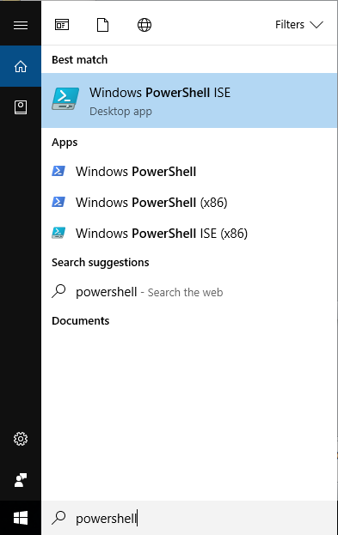
How can I access PowerShell?
Standard part of Windows 7 and 8
Can be downloaded from Microsoft Scripting Center
Once installed, can be accessed from the Start Menu like any other application
Notes:
- There is just the console version with is “windows powershell”. We’re going to use the more user friendly version “windows powershell ISE”

Slide 6
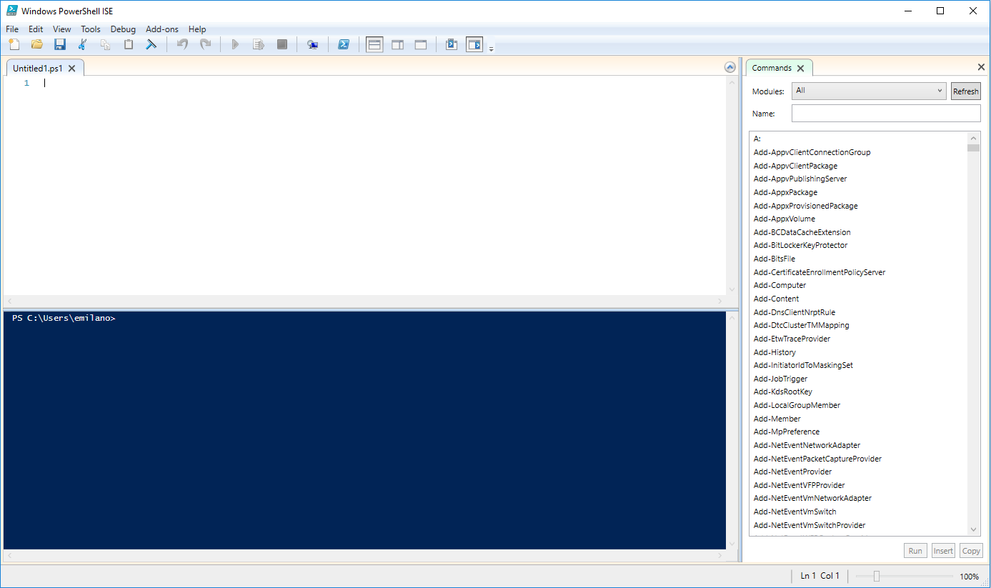
Let’s familiarize ourselves….

Slide 7
Familiar Faces
# = a comment in the script
$ = a variable in the script we define
{ } = brackets used to group statements together
‘ ‘ = define a string
| = pipe, used to “pump” an output into another command

Slide 8
Let’s walk through an example…
Let’s say I have a number of Excel files that needed to have a particular cell updated to a new value (perhaps “Revenue” in cell C3 was misspelled).
Let’s take a look at a script that will edit all of the Excel files in the specified folder and change the value of that cell…

Slide 9
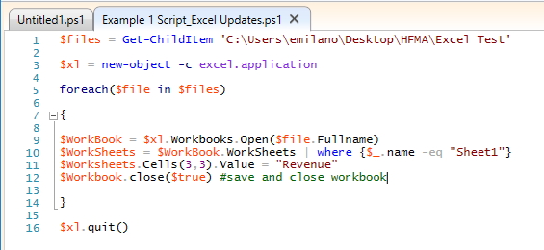
Let’s walk through an example…

Slide 10
Now let’s write one together!
Say I received six months worth of files from multiple clients. For example, a listing of account numbers and NDCs for outpatient Medicaid claims billed with >= $5,000 in drug charges
I need to reorganize them by month so that I can use the appropriate fee schedule to price the claims.
The files are big and my manager, who works off site, needs only the January files emailed to him.

Slide 11
Want more?
Microsoft Virtual Academy | Getting Started with Microsoft PowerShell
Microsoft Developer Network | Powershell

